Slide 1
Deep Blue PEMS Analysis
Python Automation

Slide 2
PEMS Analysis
Critical Tower Angles
HOM / Tensioner Hang off
Consolidation Folder
Q:\Subsea\Design Engineering\Inst Analysis\10. Consolidation\PEMS
Python script to create the orcaflex files and extract the data

Slide 3
PEMS Analysis - Steps
Input the Equipment Setting data
Analysis Parameters
Tower Angles
Create Empty and Flooded base files
Run PEMS
Post process
Create CSV files

Slide 4
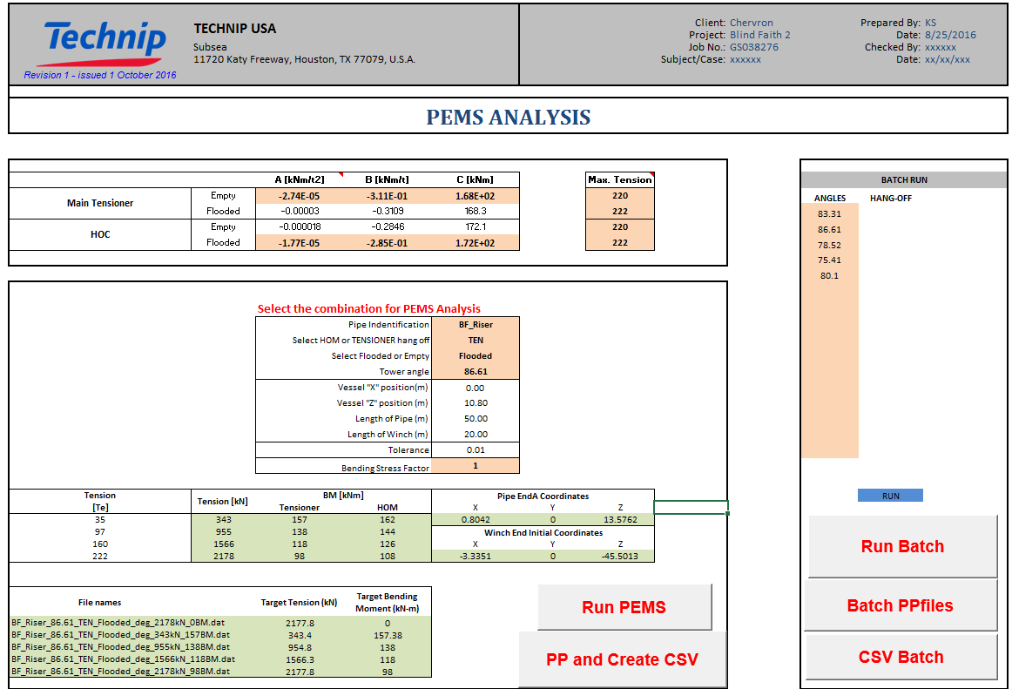
1
2
For Batch Run
3

